Slide 1

ELSA Educator Workshop
Day Two – Session Three

Slide 2
An introduction to communities of practice in the ELSA project

Slide 3
Overview & Key questions
What are communities of practice?
Domain, Community, Practice
How can we build an effective network to share ideas and learn from each other?
How can we build on what we already do now?
Where do we go next?

Slide 4
ELSA Practice Framework
STEM Practices: Ideas, Methods & Values (A way of thinking)
ERA Loop: Experience, Represent & Apply (A way of acting)
Communities of Practice: That ask and share the What, So What & What Next (A way of relating)
Notes:
ELSA PRACTICE FRAMEWORK
ELSA is a project about empowering all children, educators and families to expand their opportunities to think, act and feel about the STEM world around us.
STEM education needs help - we can do it better. It's siloed - it's been about the end game what happens at uni or work. It's been exclusive and it's been about knowledge - Knowledge has a short half life. It's not working as well as it could.
When we drill down - good Education is a complex process by which children, educators and families are initiated into:
forms of understandings (thinking)
modes of acting (acting)
ways of relating (feeling)
We call that a Practice - is a form of socially established cooperative activity comprising (Kemmis):
Actions & activities (doings)
Expressed ideas (sayings)
Networks of relationships (relating)
You can look at these from the Individual and Collective dimensions - the I and the we
ELSA Practice framework - a three step approach
A way of thinking - STEM Practices comprising Ideas, Methods & Values
A way of acting - Experience, Represent & Apply
A way of relating - Through COPs that draws on What, So What & What Next
The ELSA Practice framework helps us Notice, Design and Grow. It can be applied to children, educators and families.
The EYLF gives you key ideas that underpin successful early childhood education so that you can make your own decisions. Those ideas are: Belonging, being and becoming. Every child in our care can experience a genuine sense of belonging; if they can have time and space to be themselves; and if they can be supported in who they are becoming then we will have done a good job. We build on the EYLF idea of living practice into what we call a STEM practices approach – you can see it as a design framework. I’ll come back to that.
The infographic overviews a new and different approach to STEM practice & understanding that is interactive and practical and underpins all STEM. It is expansive, integrated, think-act-feel – most importantly it starts where kids are at – it is in inclusive

Slide 5
ELSA Practice Framework (3 Step)
STEM Practices
Ideas, Methods & Values
ERA Loop
Experience, Represent, Apply
Community of Practice
What, So What, What Next?
DIGITAL
DIGITAL

Slide 6
ELSA Practice Framework
Learning is a situated activity where learning can seen as an increasing participation in communities of practice rather than as a simple process of internalisation.

Slide 7
Represent - What is a COP?
Domain – the shared area of interest and competence (e.g. STEM practices)
Community – the people who interact in an ongoing way with an emphasis on helping each other learn (i.e. relationships and collective learning)
Practice - the practice and shared resources that get developed (experiences, stories, artifacts, tools for solving problems)

Slide 8
Represent - What is a COP?
https://image.slidesharecdn.com/5

Slide 9
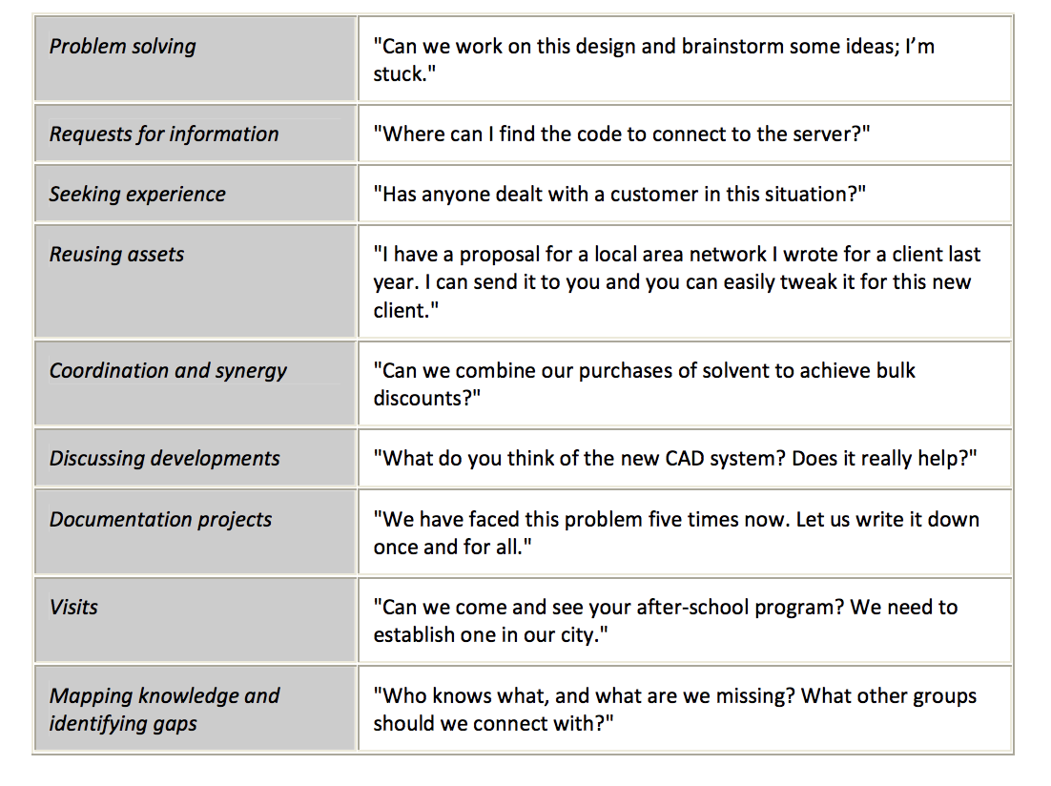
Represent - What does a CoP do?

Slide 10
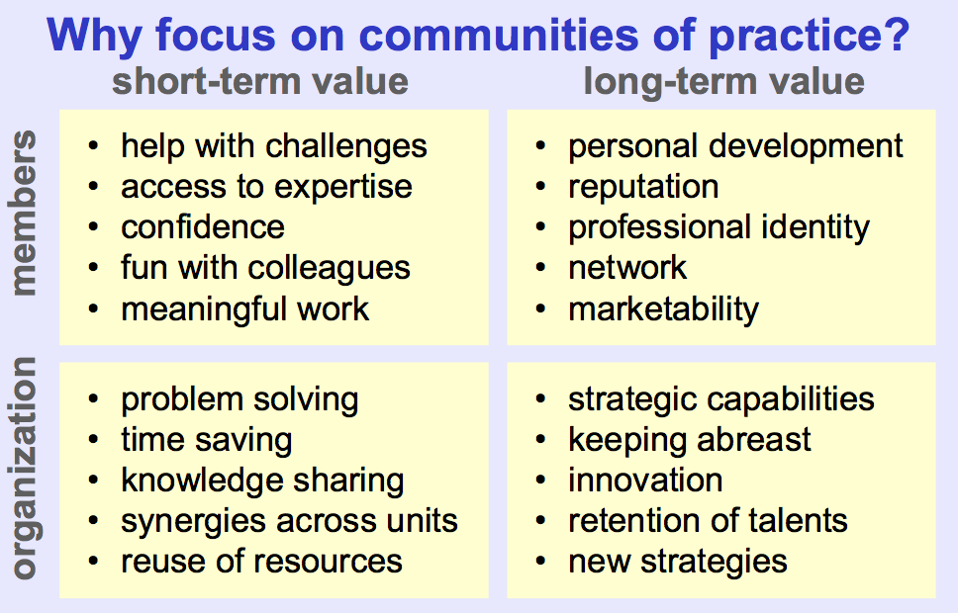
Represent – Why COP?

Slide 11
Represent – Mapping a COP
In groups, use your Post it notes to map the Domain, Community, Practice of the STEM practices and children’s literature activity.
Add more notes & ideas to fill out the each area.

Slide 12
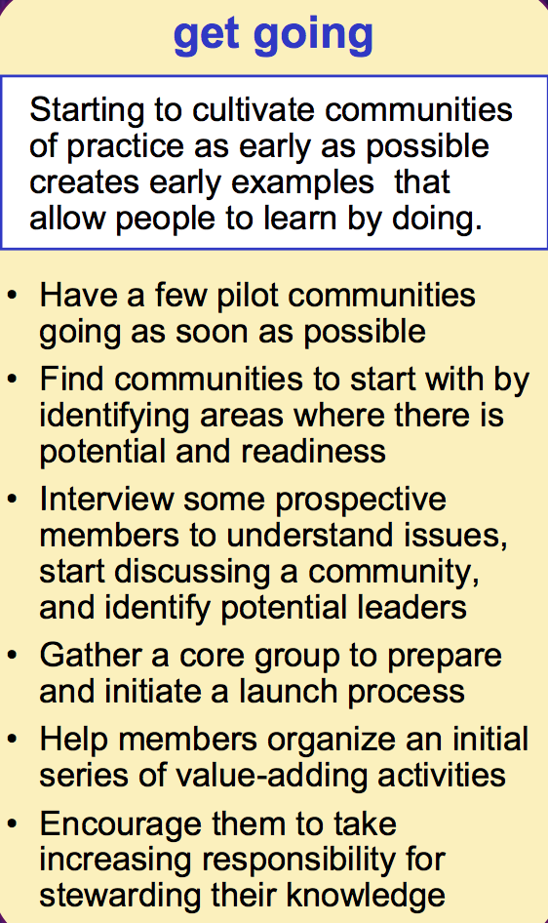
Apply – Cultivating a COP

Slide 13
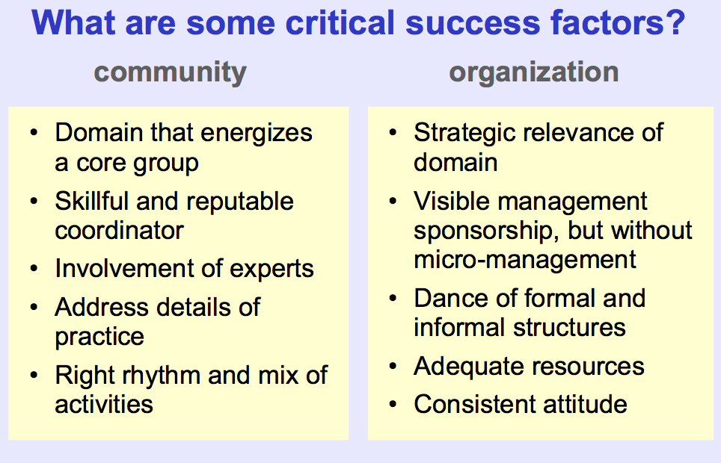
Apply – Cultivating a COP

Slide 14
Apply – Ideas to create our Community Practice Network
Network support strategies have been organised into five action areas:
Convene a community of practice;
Catalyze innovative learning projects;
Communicate within and outside the network;
Coordinate network members to maximize impact; and,
Champion the network’s accomplishments.
How will your CoP address: What, So What & What Next?
From http://remakelearning.org/playbook/plays-in-detail/#plays-in-detail

Slide 15
Apply – Next Steps
Start to develop your Action Plan

Slide 16
ELSA Action Plan

Slide 17
ELSA Action Plan
What do I need to do?
What does my centre need to do?
devices
communication
sharing
Notes:
Educators to complete Action Plan sections – have a discussion and share ideas – might be something you have not thought of yet.

Slide 18
ELSA Action Plan
How will I contribute to the Community of Practice?
Do I have contact information for at least 2 of my colleagues?
Resources to investigate
Things to remember
Notes:
Educators to complete Action Plan sections – have a discussion and share ideas – might be something you have not thought of yet.

Slide 19
Parking Lot questions…

Slide 20
Final reflection

Slide 21
Where are you now?
Wordle
Can you write down five words you now associate with early childhood STEM

Slide 22
Workshop survey
Can you please fill in the workshop survey
Thank you for your participation – we look forward to working with you in 2018

Slide 23
Thank you
Early Learning STEM Australia has been developed by the University of Canberra, through funding provided by the Australian Government Department of Education and Training under the National Innovation and Science Agenda.
Copyright in the material on this presentation is owned by the Commonwealth of Australia unless otherwise indicated. This material may be used in accordance with the Creative Commons BY 4.0 licence, unless otherwise indicated.
ELSA is funded by the Australian Government Department of Education and Training through the National Innovation and Science Agenda

